Slide 1

Phishing Website Detection
Group Assignment 4 – Progressive Demo & Retrospective 2 (15%)
Submitted By: Muhammed Murtuza
Github: github.com/Murtuzamohammed78692/Phishing_Website

Slide 2
Project Status: Background
During Sprint 2, the project advanced from initial data preprocessing into core model execution, validation, and user interface deployment.
Managing all development tracks independently, I successfully trained and compared four baseline classifiers, tuned their hyperparameters, serialized the top-performing model, and built an interactive local web interface using the Flask framework.

Slide 3
User Stories Overview
The following user stories from Kanban 2 were demonstrated live, with all corresponding tasks marked as "Done" in Jira.
• User Story K2-1 (Model Benchmarking): As a solo developer, I need to train and evaluate Decision Trees, Random Forests, SVMs, and XGBoost on our engineered feature dataset so that I can objectively choose the most accurate classifier based on F1-Score.
• User Story K2-1 (Hyperparameter Tuning & Cross-Validation): As an ML engineer, I need to implement a 10-fold cross-validation loop and adjust hyperparameter configurations to eliminate overfitting.
• User Story K2-1 (Model Serialization): As an ML engineer, I need to serialize the trained Random Forest model using the Pickle library so it can be exported cleanly into our web application environment.
• User Story K2-2 (Flask Web Integration): As a full-stack developer, I need to set up a Flask core gateway running a real-time URL prediction route to extract features dynamically and serve instant model verdicts.

Slide 4
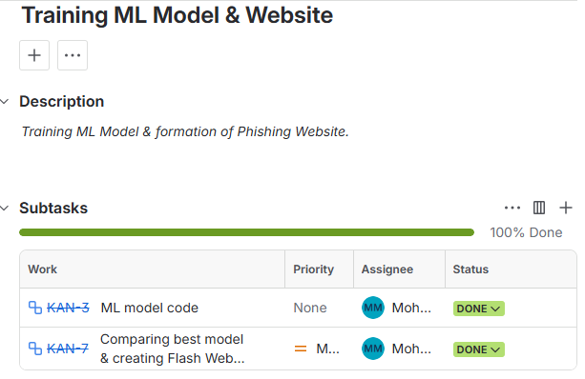
Core Functionality Validated
The progressive demonstration validated the following interactive software components:
• Multi-Model Performance Matrix: Presentation of a performance visualization proving that the Random Forest model achieved the highest operational metrics, reaching an overall accuracy of 93.7% and an F1-Score of 93.5% (outperforming Decision Tree, SVM, and XGBoost setups).
• Live UI Prediction Engine: Validation of a functional local web interface hosted at http://localhost:5000. Users can type a live URL into an input form, prompting the system to dynamically compute feature arrays and instantly return a clear "Phishing" or "Legitimate" security verdict alongside a model percentage confidence rating.
• Feature Importance Insights: Visual proof of Random Forest feature weights via Matplotlib graphs, showing that attributes like SSL Final State and URL Anchor Link Ratios provided the highest classification impact.

Slide 5
Sprint 2 Concluded

